Slide 1
The Unbanked
By Erika Toriz
Founder,
Chief Executive Officer
~~~~~~~~
Haven Services dba.
Haven Neighborhood Services

Slide 2
Erika Toriz
Mission is to educate consumers so that those who are marginalized and do not have access to basic financial principles will begin to make better financial decisions and will take advantage of economic opportunities. By educating the community, a knowledge of basic financial principles will prevent consumers from making poor financial decisions.

Slide 3
.
Our Mission Statement
To financially empower vulnerable communities by providing no-cost financial education and services to end their financial crisis.
Our Vision
To champion financial wellness through comprehensive and responsible financial education, counseling, and coaching for Low-to Moderate-Income (LMI) individuals and families in Southern California.

Slide 4
Our Direct Services
Credit Counseling
Financial Coaching
Foreclosure Prevention
Pre-Purchase Counseling
Post Purchase Counseling
Rental Counseling
VITA

Slide 5
Who Do We Serve
Low to moderate income individuals
Veterans
Undocumented Residents
LGBTQ
Homeless
Youth
Incarcerated

Slide 6
Unbanked
25% of low-income house holds are without a checking account
Being unbanked is costly:
Rely on more expensive alternatives (check cashers, money transfers,etc.)
Accumulate less wealth
Less small dollar credit (payday and overdraft)

Slide 7
Unbanked Households’ Reasons for Not Having a Bank Account, 2021 (Percent)

Slide 8
Unbanked for California, 2021 by Race/Ethnicity
Source: 2021 FDIC National Survey of Unbanked and Underbanked Households
Row Variables | Number of Households (1000s) | Number of Households (PCT) | Unbanked | Has bank account
All Households | 14619 | 100 | 5.0 | 95.0
Race/Ethnicity (PCT)
Black | 820 | 100 | 6.4 | 93.6
Hispanic | 4569 | 100 | 7.6 | 92.4
Asian | 2333 | 100 | 5.4 | 94.6
American Indian or Alaska Native | NA | 100 | NA | NA
Native Hawaiian or Other Pacific Islander | NA | 100 | NA | NA
White | 6510 | 100 | 3.1 | 96.9
Two or More Races | NA | 100 | NA | NA

Slide 9
Banking Inclusion
People need access to financial products and support that will help them rebuild trust, save money, (re)build credit, and unlock access to wealth building opportunities.

Slide 10
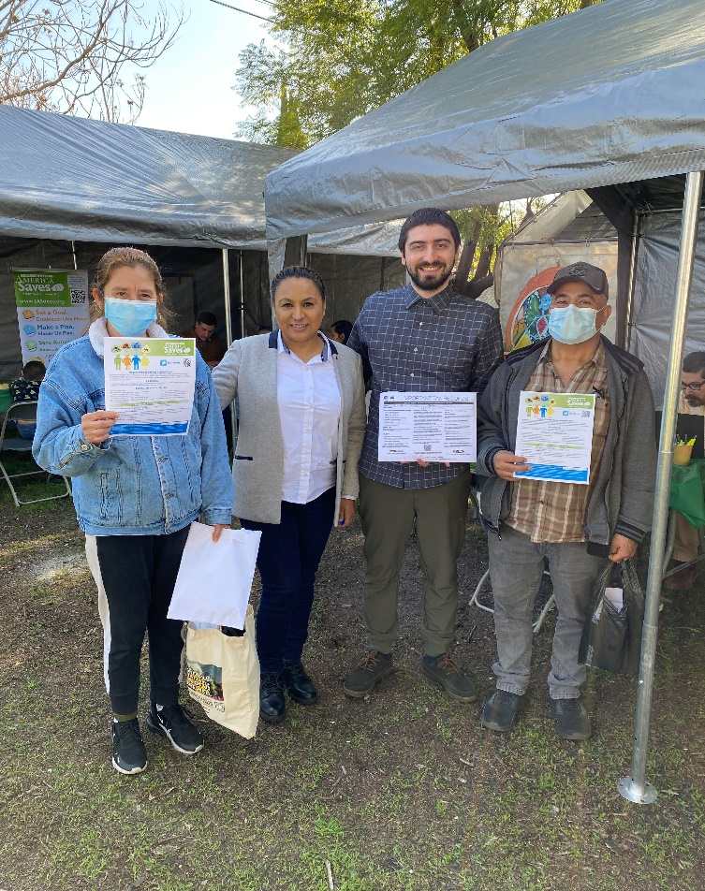
The Unbanked
Jose and Ana Saavedra
Resided in this country for 17 years.
Professionally trained as a cabinet maker.
Regularly sends money to their family in Mexico on a weekly basis.
Holds reservations or concerns about trusting the banking system.
Monolingual

Slide 11
Help Us Help the Unbaked!
Erika Toriz etoriz@havenservices.org (818)632-8766

