Slide 1
TECHNICAL ASSISTANCE WORKSHOP
CALIFORNIA DEBT LIMIT ALLOCATION COMMITTEE

Slide 2
COMMITMENT/SELLER CARRYBACK NOTE
Section 5062
1.) All documents need to be signed, dated and acceptance needs to be signed and dated by the LP.
2.) Seller Carryback notes need to be on the seller entity letterhead, signed and dated. (Industry Standard that a signature is accompanied with a date)
3.) Why is this important.

Slide 3
Demonstrated Site Control
Section 5190 of the CDLAC Regulations
CDLAC is looking to see who will be the “Post-Closing Ownership”. For CDLAC purposes, this should be the project sponsor listed in the application.
Evidence Required
Current Title Report (must be dated within 90 days of the CDLAC application deadline)
If title report shows that the Project Sponsor holds vested title fee, no further evidence is required
If the Project Sponsor does not hold vested title fee, then a Purchase and Sale Agreement between the current owner on title and the project sponsor is required.
Purchase and Sale Agreement Requirements
Must state Close of Escrow date
Must be fully executed by both parties
NOTE: If Agreement is not between the current owner and the Project Sponsor, evidence of Assignment and Assumption between the “buyer” and the Project Sponsor must be provided.
If there are liens listed on the Title Report, CDLAC wants to know if they will be “paid off at closing” or will they be “assumed” by the new owner. This information must be provided in Attachment 2-A3

Slide 4
Demonstrated Site Control (continued)
Section 5190 of the CDLAC Regulations
Site control may be evidenced by any of the following:
(A) The Applicant or Project Sponsor holds fee title as evidenced by the title report;
(B) An executed lease agreement or lease option for the length of time the Project will be 0regulated under this program between the Applicant or Project Sponsor and the owner of the subject property;
(C) An executed disposition and development agreement for the length of time the Project will be regulated under this program between the Project Sponsor and a public agency; or
(D) A valid, current, and enforceable contingent purchase and sale agreement or option agreement between the Project Sponsor and the owner of the subject property, including evidence that all extensions necessary to keep the agreement current through the date of the award of Allocation have been executed.
E) Valid, current and enforceable purchase and sale agreements, contingent purchase sale or option agreements in combination between the Project Sponsor, a third party and the owner of the subject property such that the Committee can determine that upon a grant of Allocation the Project Sponsor has a right to acquire the subject property.

Slide 8
SCHEDULE A
The estate or interest in the land hereinafter described or referred to covered by this report is: Fee simple.
Title to said estate or interest at the date hereof is vested in: KURKEN ALYANAKIAN, AN UNMARRIED MAN
The Land referred to in this report is situated in the City of Los Angeles, County of Los Angeles, State of California, described as follows:
See attached Legal Description

Slide 10
LOCAL APPROVALS & ZONING
Section 5190(b)
Please use Form Attachment 14 (Joint App) or Attachment N (CDLAC App) (examples)
Makes it consistent for the Analyst to review.
Time saving.

Slide 11
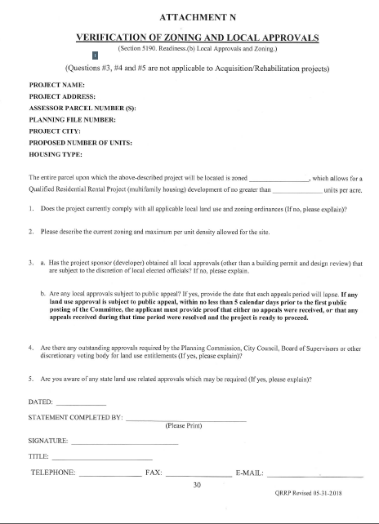

Slide 12
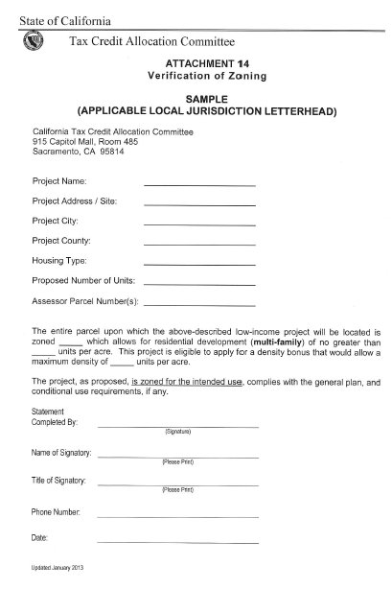

Slide 13
Legal Status Questionnaire
Section 5190(d) of the CDLAC Regulations
The official name of the case (i.e. ABC v DEF)
The date it was filed
A detailed description of the case
The current status of the case
CDLAC is looking to determine if there are any legal issues that could potentially affect the financial viability of the project.

Slide 14
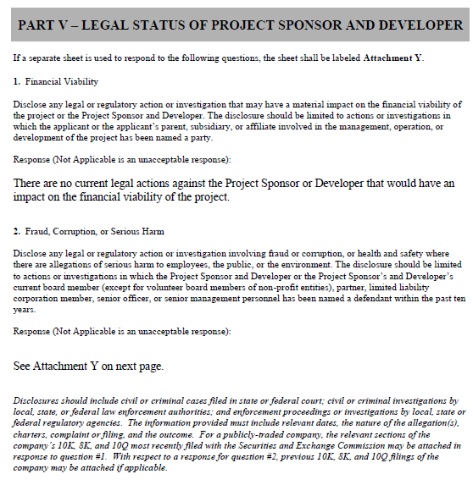

Slide 15
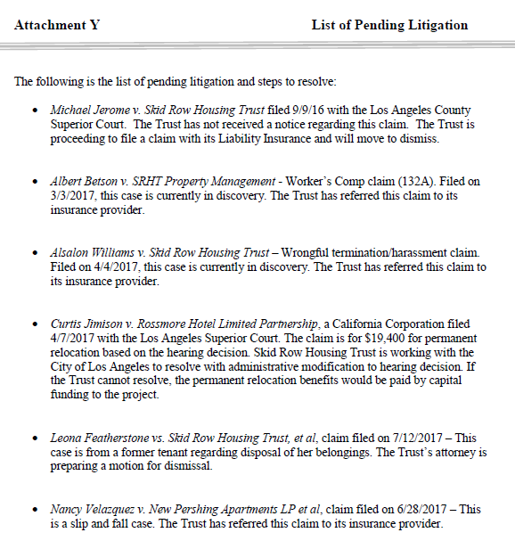

Slide 16
PROJECT DESCRIPTION
Section 5190(h)
Please make sure all the areas requesting descriptions are covered (items 1-9)
What has been missing:
1.) Acres
2.) Target population
3.) Expected start and completion dates
4.) Scope of rehabilitation

Slide 17
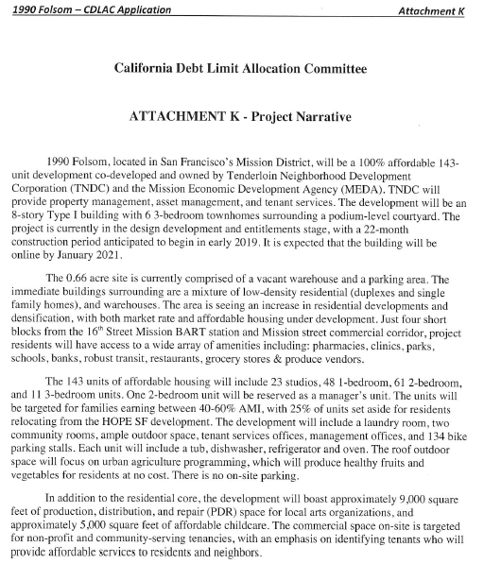

Slide 18
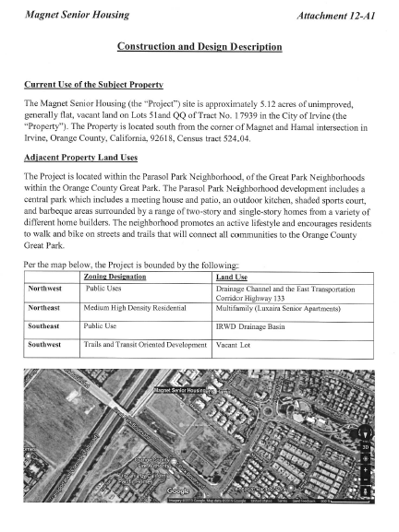

Slide 19
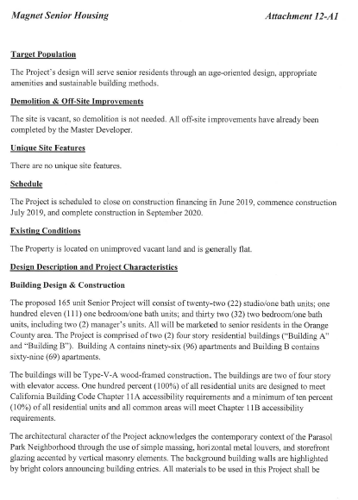

Slide 20
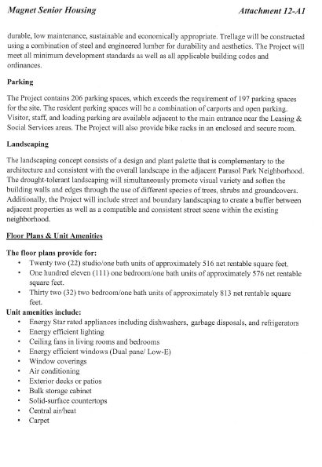

Slide 21
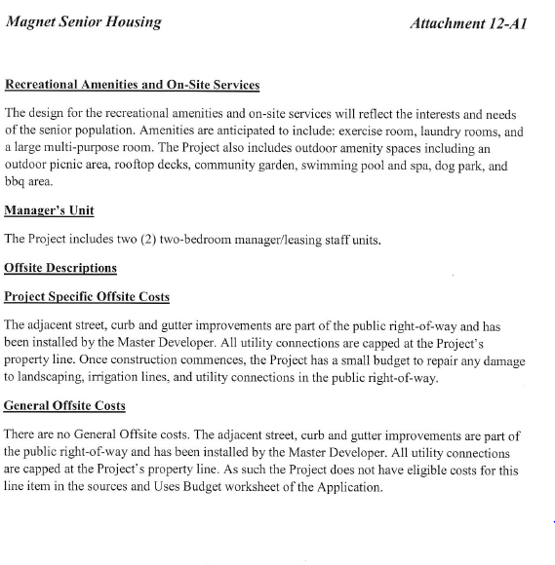

Slide 22
EVIDENCE OF RENT SUBSIDY
Section 5190(h)(A)(i)
This is part of the Preservation review also:
1.) Claiming Preservation needs to have the documentation attached.
2.) Attachment 17-A, 17-B1 for the Joint app or L, L1, L2 for the CDLAC app.
3.) Why this is needed.
4.) What else this triggers to the benefit of the project.

Slide 23
Affordable Units
Utility Allowance
CDLAC is looking for:
Consistency in the tenant paid rent and the Rent Comparability Matrices
CDLAC is comparing the smallest unit with the highest rent for each unit type to the same unit type in the market.
If the project includes rent subsidies (i.e. HUD Section 8 vouchers, local Section 8 vouchers, etc.), please provide evidence thereof (i.e. HUD HAP (Housing Assistance Program) Contract, etc.).
Federal Bond-Election of 20% at 50% of the Area Median Income (AMI), or 40% at 60% AMI. This shall mean that the Project units must have Gross Rents that are restricted to households whose incomes must be 50% or less of the AMI; or Gross Rents that are restricted to households whose incomes must be 60% or less of the AMI.

Slide 24
Affordable Units (continued)
If a letter from the local public housing authority is applicable, please make sure that it is included as specified.
Please make sure that the applicable components are clearly identified (need example) on the utility allowance schedule as specified.

Slide 25
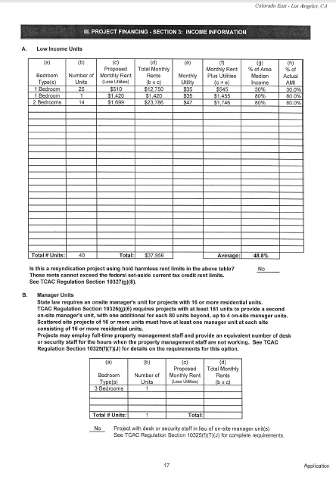

Slide 26
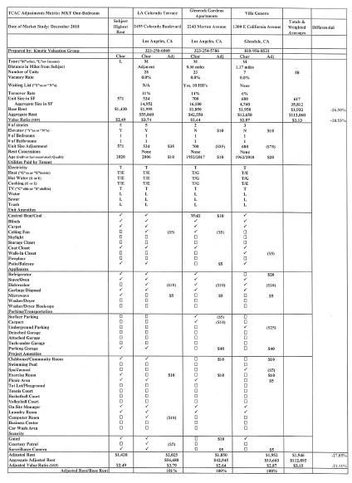

Slide 27
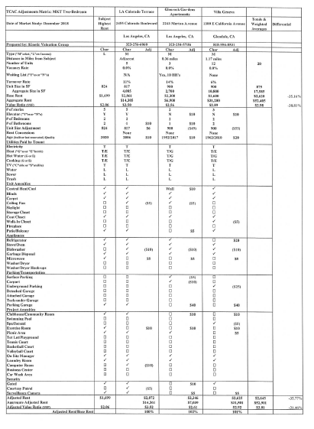

Slide 28
UTILITY ALLOWANCE
Section 5191(c)(1,2)(A) or (B)
1.) Why the Letter is important
2.) Why the Utility allowance schedule
3.) Why CUAC needs to be reviewed by TCAC

Slide 29
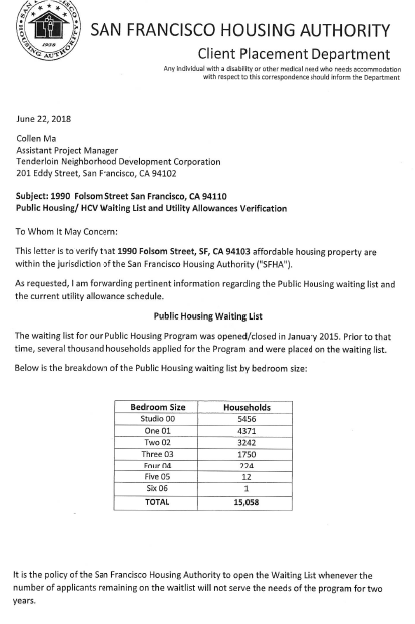

Slide 30
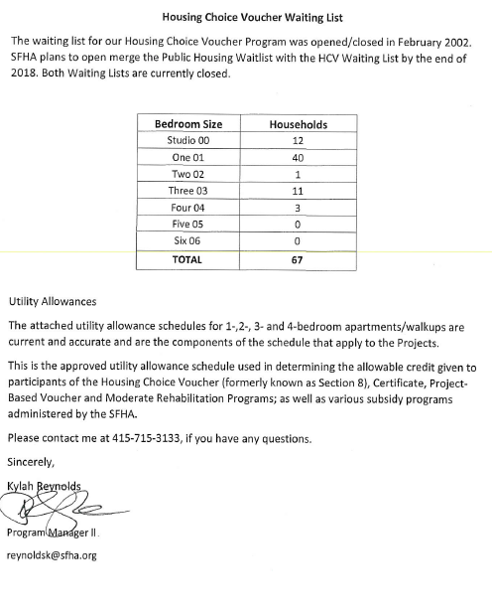

Slide 31
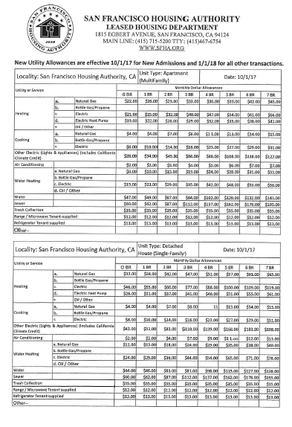

Slide 32
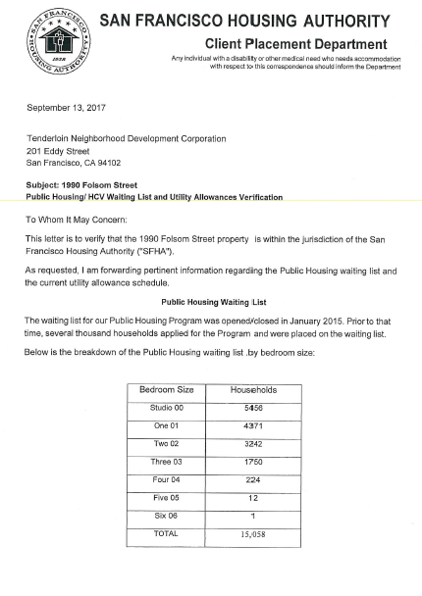

Slide 33
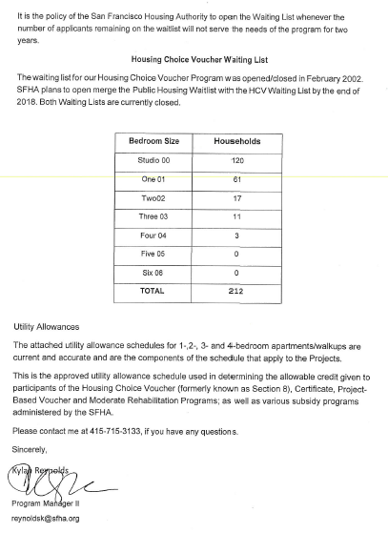

Slide 34
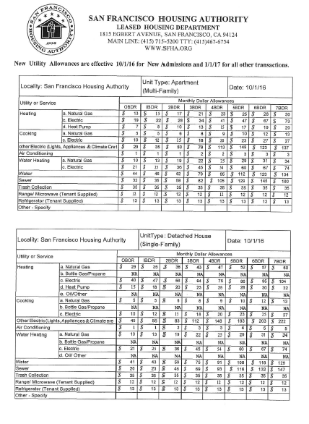

Slide 35
Liens On Title
Section 5194(c)
All liens to be included in the proposed financing should be itemized and a list of all liens to be paid off at closing should be provided as Attachment E-3: Disposition of Current Outstanding Liens. All non-assumed liens to be paid off at closing shall separately listed including lender/loan, amount, disposition and corresponding exception number from the Title Report;

Slide 36
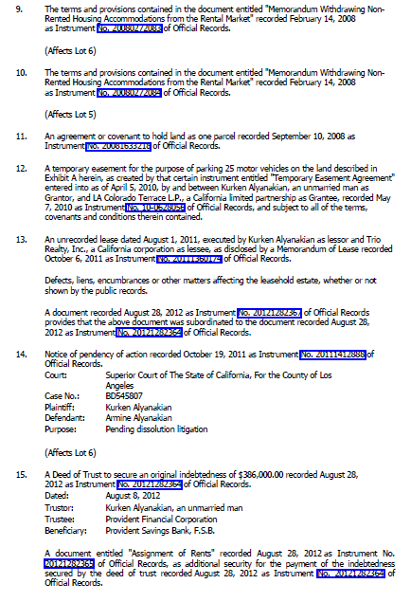

Slide 37
MARKET STUDY’S & CAPITAL NEEDS ASSESMENT
Section 5200(d), Section 5212
1.) For the both reports, it is the Site Inspection Date that needs to be 180 days or less of the application date, not the report date.
2.) For the refresh of Market Study, less than 12 months of first Site Inspection Date.
3.) Please check you CNA to make sure that it had the 15 year reserve study.

Slide 38
SUSTAINABLE BUILDING STANDARD
Section 5205
All waivers must be submitted to CDLAC at least ten (10) business days prior to the application deadline.
1.) Why CDLAC cannot move forward without this waiver documentation
2.) Who does the review of the waiver
3.) Why your project needs to request it as soon as possible

Slide 39
SERVICE AMENITIES
Section 5230(l) (1)(A-D)(2)(A-E)
1.) Copies of Contracts need to be provided along with job description of the contractor providing the service
2.) Hours must be listed (84 hours per year, 100 hours per year)
3.) Bona fide service coordinator. Contractor needs to spell out services, number employees providing services (yes it can just be one) and the employee job description
4.) Budget for the services must be attached
5.) Attachment U for CDLAC app and Attachment 24 for the Joint app.

Slide 40
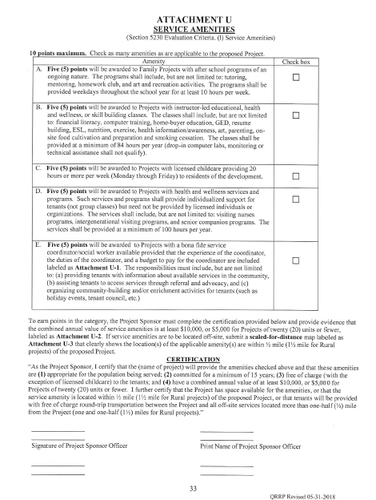

Slide 41
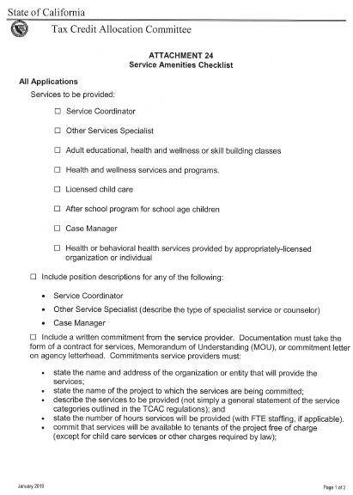

Slide 42
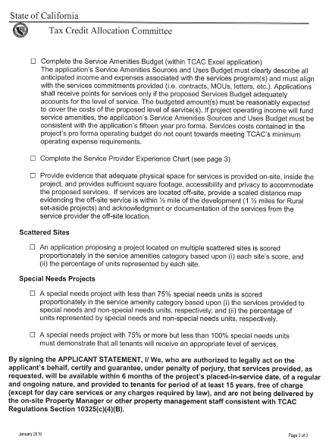

Slide 43
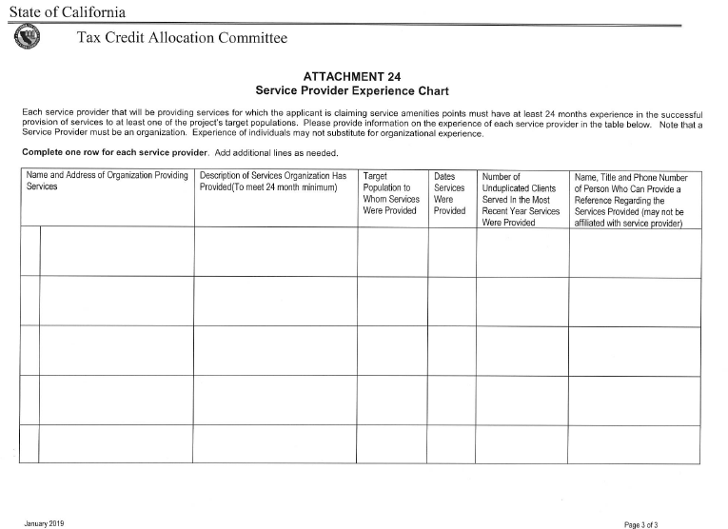

Slide 44
Site Amenity Point Category
If a project is seeking points for these specific amenities, the following evidence is required to garner points:
Transit (2.5 points)
A scaled for distance map evidencing that the project is located within one-third (1/3) mile of a Public Transit Corridor or, for Rural Projects where there is no public transportation system, to projects using a van or dial-a-ride service; or located within one-half (1/2) mile of a High Quality Transit stop or station.
Applicable transit schedule
(please refer to regulations for more details regarding potential additional points)

Slide 45
Site Amenity Point Category (continued)
Shopping (2.5 points)
A scaled for distance map evidencing that this amenity is i) within one-half (½) mile (1 mile for Rural Projects) of a full service grocery store of at least 25,000 gross interior square feet; or ii) Two and one-half (2 ½) points will be awarded to Projects located within one-fourth (1/4) mile (one-half (½) mile for Rural Projects) of a full service grocery store of at least 5,000 gross interior square feet.
Evidence shall include, but is not limited to, the following: a signed letter from a county assessor or city planner for that jurisdiction certifying the square footage of the grocery store, a letter from the store manager, or a letter from the Project’s architect. The letter must state the square footage of the grocery market.
School (2.5 points)
A scaled for distance map evidencing that this amenity is site is within 1/4 mile of a public elementary school; 1/2 mile of a public middle school; or one (1) mile of a public high school that children living in the development may attend (an additional 1/2 mile for each public school type for Rural projects) and that the site is within the attendance area of that school. Projects where all units are restricted to households having members 55 years or older, shall not be eligible for points in this category.
Evidence shall include, but is not limited to, the following: a signed letter from the school district with the appropriate Project address stating said address is within the boundaries of the school, or documentation from an internet-based school locator tool.

Slide 46
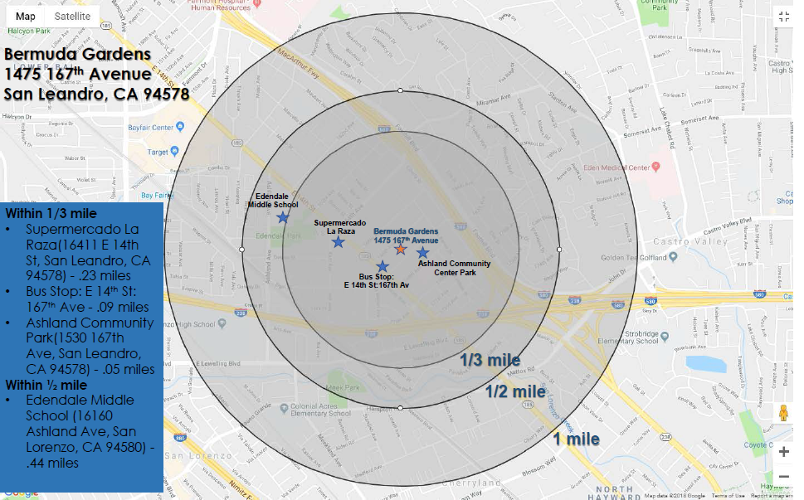

Slide 47
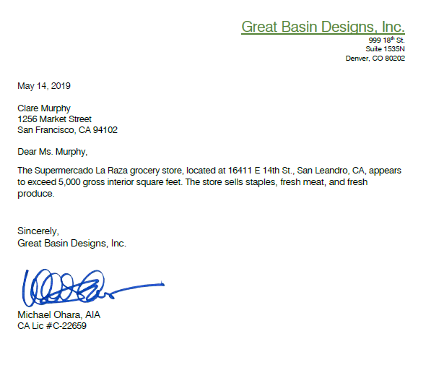

Slide 48
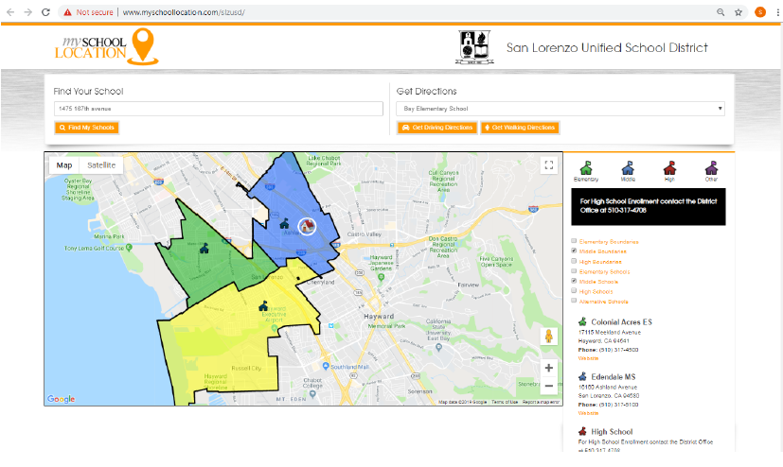

Slide 49
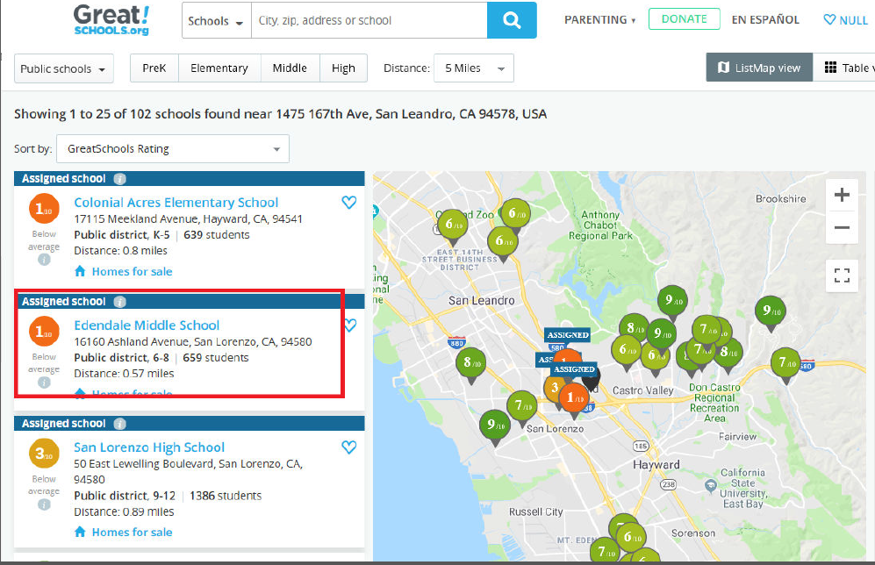

Slide 50
SCATTERED SITE APPLICATIONS
Section 5250 (2),(3)(B),(4),(5)
Rule of thumb here is that every site within the application must be able to support itself as if it was being reviewed separately. All documentation that is necessary for one site in a regular application applies to all the sites.

Slide 51
Difficult to Develop Area (DDA) Project
Article 12 Section 5258 of the CDLAC Regulations
When the project determines which CDLAC meeting it wishes to seek an allocation, all date stale documents and all material changes along with any and all applicable supporting documentation must be submit by the application deadline for that specific CDLAC allocation meeting.
Some examples of date sensitive documents are as follows:
Title Report (within 90 days of the application deadline for the applicable CDLAC meeting)
Purchase & Sale Agreement (if expired)
Assignment & Assumption Agreement (if applicable and if expired)
Capital Needs Assessment (if applicable)
Market Study (prepared within 180 days of the Application deadline) [see Section 5200 for more details)

Slide 52
Difficult to Develop Area (DDA) Project (continued)
If the financial structure has changed, some updates needed are:
Financial description
Sources and Uses (during both construction and permanent financing phases)
Lender Commitment letter(s)

Slide 53
RDA LOANS
Page 8 of the application.
If your Project is assuming a Redevelopment Agency Loan, you must fill out the required information on Page 8 of the application regarding RDA loans.
How do we know you have not listed it?

Slide 54
HARD CONSTRUCTION COSTS
Inconsistency between Attachment 40 (Sources and Uses tab) and Attachment 8-A/8-B (Itemized Breakdown of the Hard Construction Costs).
Please make sure that the totals of these two documents are consistent.

Slide 55
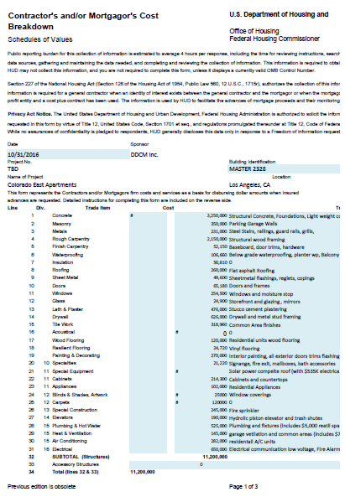

Slide 56
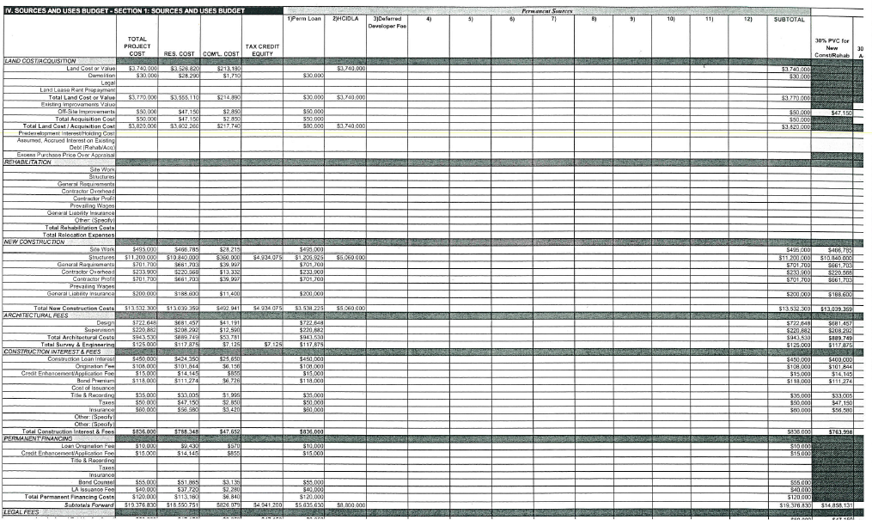

Slide 57
PERFORMANCE DEPOSIT CLARIFICATION
Please make sure that:
1.) Copy of the deposit check is attached, or
2.) Copy of the wired deposit is attached

Slide 58
HIGH COST PER UNIT
Looking for 4 things.
1.) Allocation Request Amount
2.) Cost per unit
3.) Cost per square foot
4.) A clear explanation of why

