Slide 1
Demographic approaches to estimating the prevalence of COVID-19 bereaved children
Emily Smith-Greenaway
Associate Professor
Sociology & Spatial Sciences
University of Southern California

Slide 2
Approach #1: Demographic microsimulations to generate a ‘bereavement multiplier’
1
2
3
Representative estimates of U.S. kinship networks
Correspondence between simulation & surveys
Model age pattern of COVID-19 deaths on estimated U.S. kinship networks
Demographic microsimulation
Computational model of U.S. family relationships
Despite limited data on non-household family
Extends to age patterns of relationships
Survey analysis
Analyze available surveys with data on all living family
Verdery, Ashton M., and Rachel Margolis. "Projections of white and black older adults without living kin in the United States, 2015 to 2060." Proceedings of the National Academy of Sciences 114.42 (2017): 11109-11114.
Daw, Jonathan, Ashton M. Verdery, and Rachel Margolis. "Kin count (s): Educational and racial differences in extended kinship in the United States." Population and Development Review 42.3 (2016): 491.

Slide 3
COVID-19 family bereavement
~9 people lose a close family member for each COVID-19 death
1.5
1.25
Bereavement Multiplier
1
9 X 102,350 COVID-19 deaths in California =
~921,150 bereaved by COVID-19 death in their family
.75
.5
.25
0
00-09
10-19
20-29
30-39
40-49
50-59
60-69
70-79
80-89
90 plus
Age group
95% of combined estimated distribution
Combined
Black
White
Verdery, A. M., Smith-Greenaway, E., Margolis, R., & Daw, J. (2020). Tracking the reach of COVID-19 kin loss with a bereavement multiplier applied to the United States. Proceedings of the National Academy of Sciences, 117(30), 17695-17701.

Slide 4
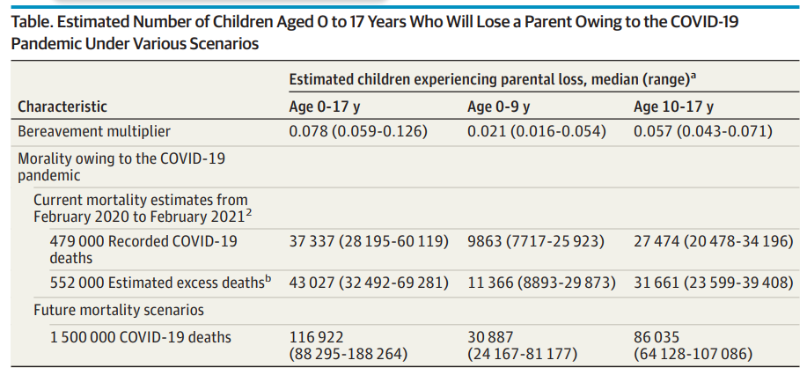
Kidman, R., Margolis, R., Smith-Greenaway, E., & Verdery, A. M. (2021). Estimates and projections of COVID-19 and parental death in the US. JAMA pediatrics, 175(7), 745-746.

Slide 5
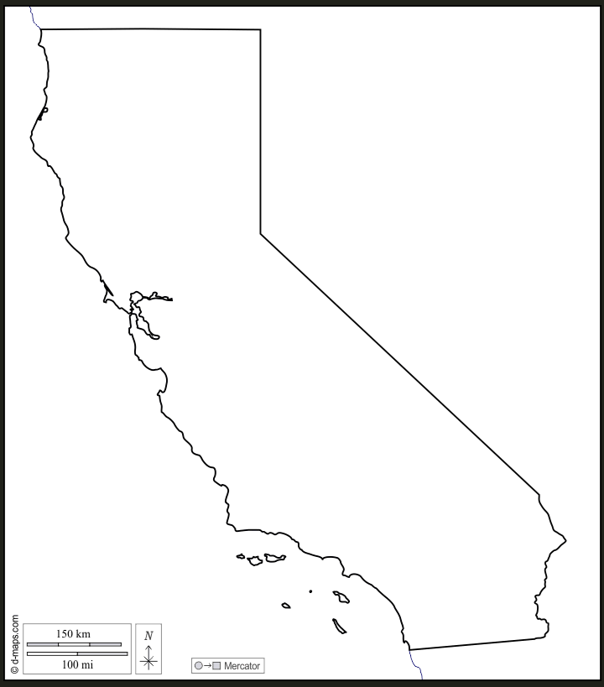
Multiplier approach: Estimated number of children parentally bereaved by COVID-19, California
~7,980 children 0-17-years-old lost a parent
[~6,040 – 12,900]
~2,150 children 0-9-years-old lost a parent
[~1,640 – 5,530]
~5,830 children 10-17-years-old lost a parent
[~4,401 – 7,260]
*as of July 7, 2023
Kidman, R., Margolis, R., Smith-Greenaway, E., & Verdery, A. M. (2021). Estimates and projections of COVID-19 and parental death in the US. JAMA pediatrics, 175(7), 745-746.

Slide 6
Strengths
Limitations
Flexible tool; track in lockstep fashion with death toll
No ‘waiting for data’ – only data needed are # of COVID-19 deaths, ~1 day lagged
Interested in projections? With estimated # of COVID-19 deaths, offers a guidepost
Not particularly precise—statistical uncertainty around estimate
Extrapolates from Black and White family structures
Assumes family structures and mortality patterns relevant to California

Slide 7
Approach #2: Combined population & mortality data to calculate parental death exposure
Population data
ACS 1-yr data (via IPUMS USA) to estimate population sizes and co-resident compositions. The data were coded to correspond with the mortality data from CDC WONDER
Mortality data
CDC WONDER Underlying Cause of Death is the source used for 2000–2022 mortality rates. The data were coded into five racial groups: non-Hispanic White, non-Hispanic Black, non-Hispanic Indigenous, non-Hispanic Asian, and Hispanic.
Datasets were joined using age, gender, race, state, and year combinations. Gender-specific findings are not presented.
https://evermore.org/
https://evermore.org/wp-content/uploads/2023/01/Evermore-Childhood-Report.pdf

Slide 8
Number of Parentally Bereaved Children
Multiply the number of deaths by the average number of co-resident children in each age, gender, race, state, and year grouping. These estimates constitute the annual rates of bereaved children.
Number of COVID-19 Bereaved Children
Same approach but substitute COVID-only mortality data.

Slide 9
COVID-19 bereaved children in California, by year
2022 estimates based on preliminary, incomplete data as of 7/2022.

Slide 10
Parentally bereaved children in California, by year (by COVID-19 and all-cause)

Slide 11
Strengths
Can produce tailored estimates at state (and even county!) level
Data publicly available
Limitations
Data about 6-months + lagged
Assumes parents and non-parents are similarly likely to die within age-race-ethnicity-geographic-year groups. Notably, research suggests that households with children were more likely to contract COVID-19 early in the pandemic than households without children, given children’s greater extra-household contact (e.g., school attendance). Any bias would lead to an underestimate of COVID-19 bereavement in 2020.
Includes any co-resident parent, including biological parents, adoptive parents, and stepparents, in its calculations.

Slide 12
Strengths
Limitations
Can produce tailored estimates at state (and even county!) level
Data publicly available
Data about 6—10 months + lagged
Assumes parents and non-parents are
similarly likely to die within age-race-ethnicity-geographic-year groups.
Includes any co-resident ‘parent’, including biological parents, adoptive parents, and stepparents.

Slide 13
Other sources—patchwork approach?
US Foster system data AFCARS – state-specific report (2021 fiscal year available)
Only 64 children entering from parental death in 2021
Social Security beneficiary data
https://www.ssa.gov/oact/STATS/SRVbenies.html
State specific estimates: 158,316 children receiving benefits in California, December 2021
Yet, Of the nation’s two million children who have a deceased biological mother or father, only an estimated 45 percent receive Social Security benefits. The number of fully orphaned children receiving the benefit is similarly low—estimated at 49 percent.
Weaver, Survey of Income and Program Participation
“Parental Mortality and Outcomes Among Minor and Adult Children,” Population Review 58, no. 2 (September 2019), https://papers.ssrn.com/sol3/papers.cfm?abstract_id=3471209.
National Survey of Child’s Health
State-level findings
https://www.childhealthdata.org/browse/survey/results?q=7208&r=1
2.5% prevalence among under 18s, 2018-2019 in California
Backing out incidence (as function of prevalence/duration): ~0.138% per year
1.9% prevalence among under 18s, 2020-21 in California
Backing out incidence (as function of prevalence/duration): ~0.105% per year
Indirectly estimate fraction of deaths attributable to COVID-19?

Slide 14
Thank you
Emily Smith-Greenaway University of Southern California
smithgre@usc.edu
Ashton M. Verdery The Pennsylvania State University
Alexander Chapman The Pennsylvania State University
Joyal Mulheron Evermore Foundation
Rachel Margolis University of Western Ontario
Jonathan Daw The Pennsylvania State University
We thank Carl Mason and the Department of Demography at the University of California, Berkeley for facilitating our access to the Socsim demographic microsimulation program, and Léa Pessin and Brandon Wagner for comments. We acknowledge support from the National Institute on Aging (1R01AG060949); the Pennsylvania State University Population Research Institute, which is supported by an infrastructure grant by the Eunice Kennedy Shriver National Institute of Child Health and Human Development (P2C-HD041025); the University of Southern California Center for the Changing Family; and the Government of Canada: Canadian Institutes of Health Research (MYB-150262) and Social Sciences and Humanities Research Council (435-2017-0618 and 890-2016-9000). Data collection for the Panel Study of Income Dynamics was partly supported by the NIH (R01 HD069609) and the NSF (1157698). The content is solely the responsibility of the authors and does not necessarily represent the official views of the NIH or other funding sources.

